Slide 1
The Best of Both Worlds – Combining
the QNX Hypervisor for Safety and
Virtualized Android using the
Google ‘trout’ Configuration
Randy Martin Senior Product Manager
Notes:
Jw notes
-- Inconsistency between this slide and slide 11 (7 of 7 tier 1s while slide 11 says 7/8 tier 1s)

Slide 2
Agenda
Trends
Hypervisor designs: Digital cockpit, rear seat, high-performance compute
Digital cockpit demonstration (Android ‘trout’ configuration)
Futures
2

Slide 3
Trends in Virtualization
THE CLOUD
ARM Virtual Hardware, Intel virtual environments
Developers expect to easily migrate from cloud development to embedded target
CHIP VENDORS ARE ACTIVE
ARMv9, Virtualization Host Extensions (VHE)
Next generation Intel
More cores per SoC
STANDARDS, SUCH AS VIRTIO 1.2 REMAIN STRONG AND ACTIVE
More virtual device interfaces being created for Android/Linux/any OS
SoC and hypervisor vendors are providing both custom virtual solutions and standards-based solutions, and sometimes a mix of both
Google is active in virtualization of Android (Android 12, 13)
Virtual devices then migrate to Linux common kernel as well
3

Slide 4
Hypervisor Designs
SERVICE OS CONTAINS THE SOFTWARE THAT SUPPORTS THE GUEST:
Shared devices, such as disks, networking, graphics, audio
System monitoring, failover
Service OS in virtual machine
Service OS in hypervisor host
4

Slide 5
Service OS in a Virtual Machine
Service OS / Domain0
Guest OS
Driver support
(pass-through)
Guest drivers virtual
Proprietary
sharing
Selective pass-through to hardware
Hypervisor
= virtual machine
5

Slide 6
Service OS in Hypervisor Host
Guest OS
Guest drivers virtual
Proprietary
sharing
Selective pass-through to hardware
Hypervisor
Driver support
Sharing support
= virtual machine
6

Slide 7
QNX® Hypervisor Microkernel Design
‘QVM’ VIRTUAL MACHINE MANAGER
Separate from the microkernel
Competes with other host processes for CPU time and resources based on priority
Can be given dedicated cores or share
Safety certified
System RAM
Hypervisor host
Guest OS running in a virtual machine
vcpu0
User Process A
vcpu1
Driver Process B
Create/destroy
Command/control
One QVM per guest
A QVM may be destroyed and restarted without rebooting
If QVM dies, the rest of the system continues operating
QNX Hypervisor microkernel
Private secure interface
IPC
Scheduling
Memory allocation
Virtualization extensions
QVM
vcpu = virtual CPU
7

Slide 8
Virtualization of Android
© 2022 BlackBerry Limited. All Rights Reserved.
8

Slide 9
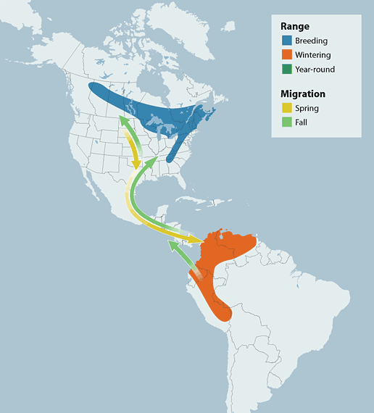
Relaxation Break
CANADA WARBLER
Small, like a microkernel!
10 grams, 8 cm tall
Migrates over 5000 km
https://youtu.be/ULxMbnfbKUw used with permission
9

Slide 10
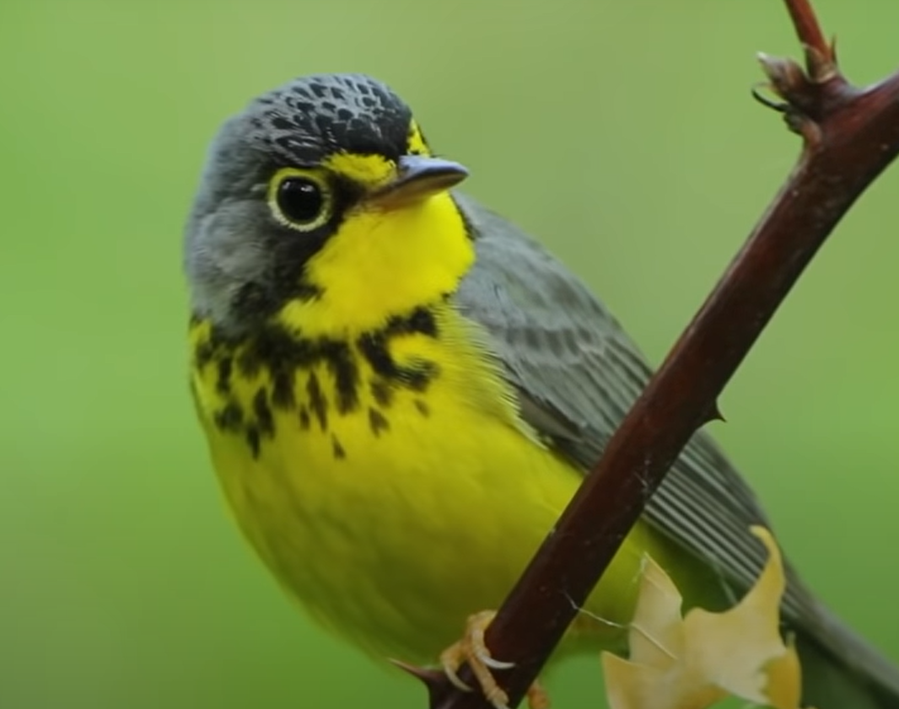
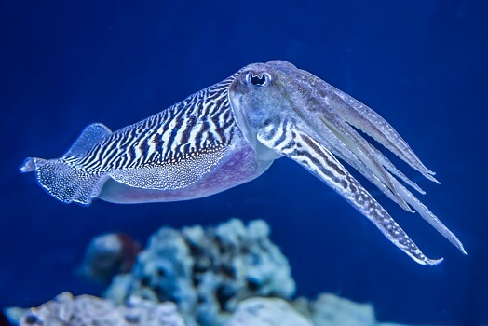
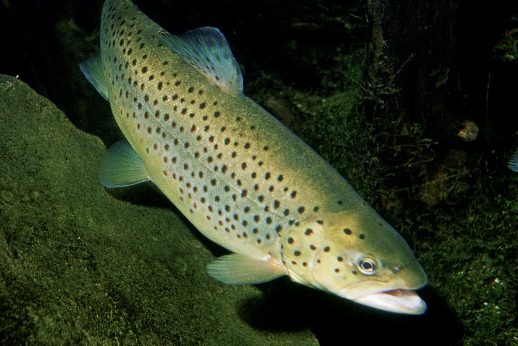
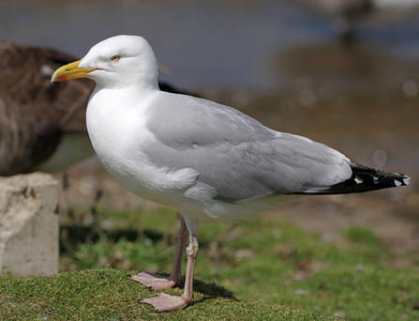
Google and Android® Virtualization: Many Animals to Remember
WARBLER
GULL
CUTTLEFISH
Virtual Android device
More advanced than Android Emulator
TROUT
Android Automotive OS built from Cuttlefish
BIRD VARIANTS
Hardware and OS specific implementations of trout
10

Slide 11
QNX Integration Goals for trout Configuration
PROVIDE UNBOUNDED USER EXPERIENCE
Android environment and non-Android environment blend together seamlessly
Designer freedom
MEET KEY REQUIREMENTS
Functional safety, mission-critical cluster
Performance, boot times, audio latency
SUPPORT LATEST ANDROID VERSIONS, MIDDLEWARE AND EXTENSIONS
No kernel modifications, support for Vulkan drawing APIs, GfxStreams, USB sharing etc.
11

Slide 12
Digital cockpit: No guests running yet
CRITICAL CLUSTER SOFTWARE
Instrumentation
Telltales
Cameras
Video streaming
Cluster display
CRITICAL IVI SOFTWARE
Cameras
Video streaming
Vehicle HAL
Graphics
Audio
System wide audio management
Touch events
Vehicle data
Audio
USB
Network
Vehicle data
IVI
Hypervisor-enabled QNX microkernel (safety-certified)
12

Slide 13
Digital cockpit: Android guest
CRITICAL CLUSTER SOFTWARE
Instrumentation
Telltales
Cameras
Video streaming
virtio-gpu
virtio-snd
virtio-blk
virtio-vsock
virtio-input
virtual Bluetooth
Sensor data
virtio-net
virtio-video virtio-scmi
virtual camera etc.
Cluster display
Android guest
CRITICAL IVI SOFTWARE
Cameras
Video streaming
Vehicle HAL
Graphics
Audio
System wide audio management
Touch events
Vehicle data
Audio
USB
Network
Vehicle data
IVI
Hypervisor-enabled QNX microkernel (safety-certified)
13

Slide 14
Digital cockpit: Optional Linux guest
virtio-gpu
virtio-blk
virtio-net
virtio-vsock
virtio-scmi
CRITICAL CLUSTER SOFTWARE
Instrumentation
Telltales
Cameras
Video streaming
virtio-gpu
virtio-snd
virtio-blk
virtio-vsock
virtio-input
virtual Bluetooth
Sensor data
virtio-net
virtio-video virtio-scmi
virtual camera etc.
Linux guest (optional)
Cluster display
Android guest
CRITICAL IVI SOFTWARE
Cameras
Video streaming
Vehicle HAL
Graphics
Audio
System wide audio management
Touch events
Vehicle data
Audio
USB
Network
Vehicle data
IVI
Hypervisor-enabled QNX microkernel (safety-certified)
14

Slide 15
Rear Seat Entertainment: No Guests Running Yet
CRITICAL RSE SOFTWARE
Video streaming
Graphics, audio, USB
Connected apps with controlled content
GLES/Vulkan apps
Media support
Audio management
Connections to cockpit
Touch
Audio
USB
Network
RSE1
RSE2
Hypervisor-enabled QNX microkernel (safety-certified)
15

Slide 16
Rear Seat Entertainment: Android Guests
Videostreaming/YouTube™
Google Play™
Android browser and media processing
Multi-zone audio
Connections to cockpit
virtio-gpu
virtio-blk
virtio-vsock
virtio-input
virtual camera
virtio-snd
virtio-net
virtio-video
virtual Bluetooth
Android guest 1
Android guest 2
CRITICAL RSE SOFTWARE
Video streaming
Graphics, audio, USB
Connected apps with controlled content
GL ES/Vulkan apps
Media support
Audio management
Connections to cockpit
Touch
Audio
USB
Network
RSE1
RSE2
Hypervisor-enabled QNX microkernel (safety-certified)
16

Slide 17
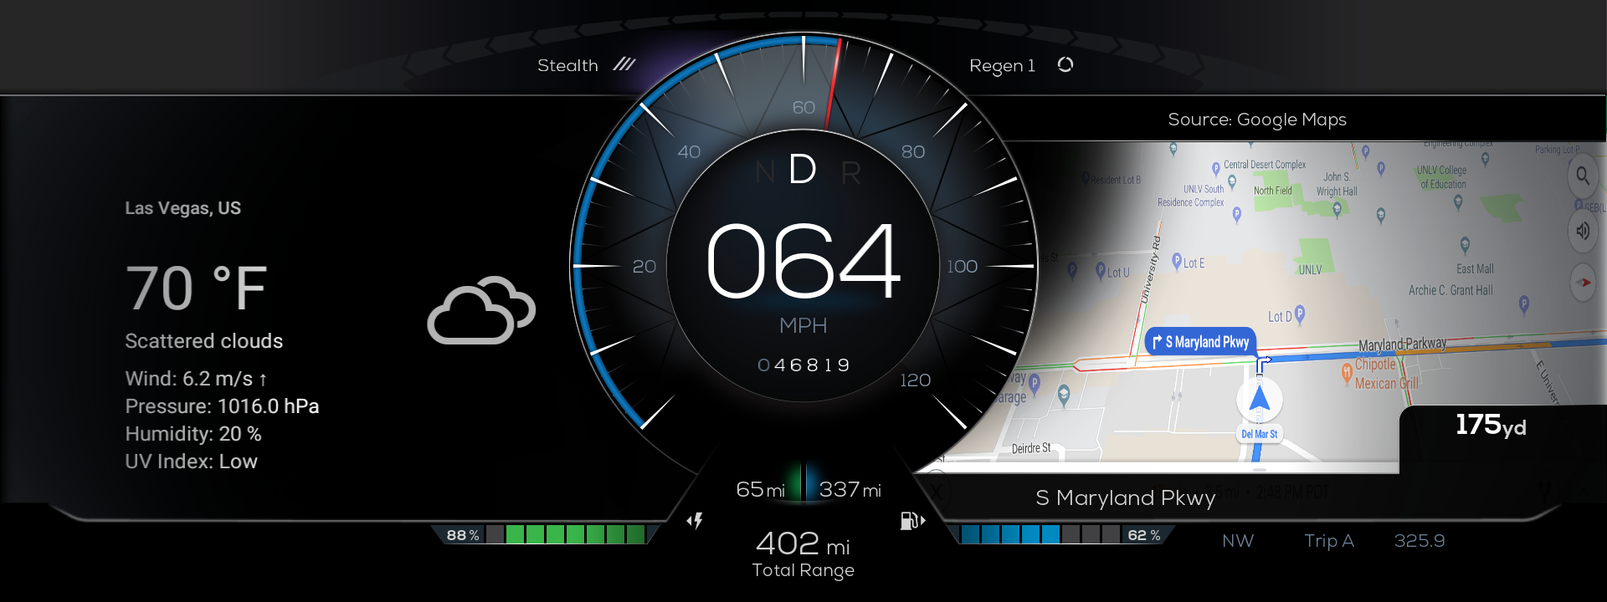
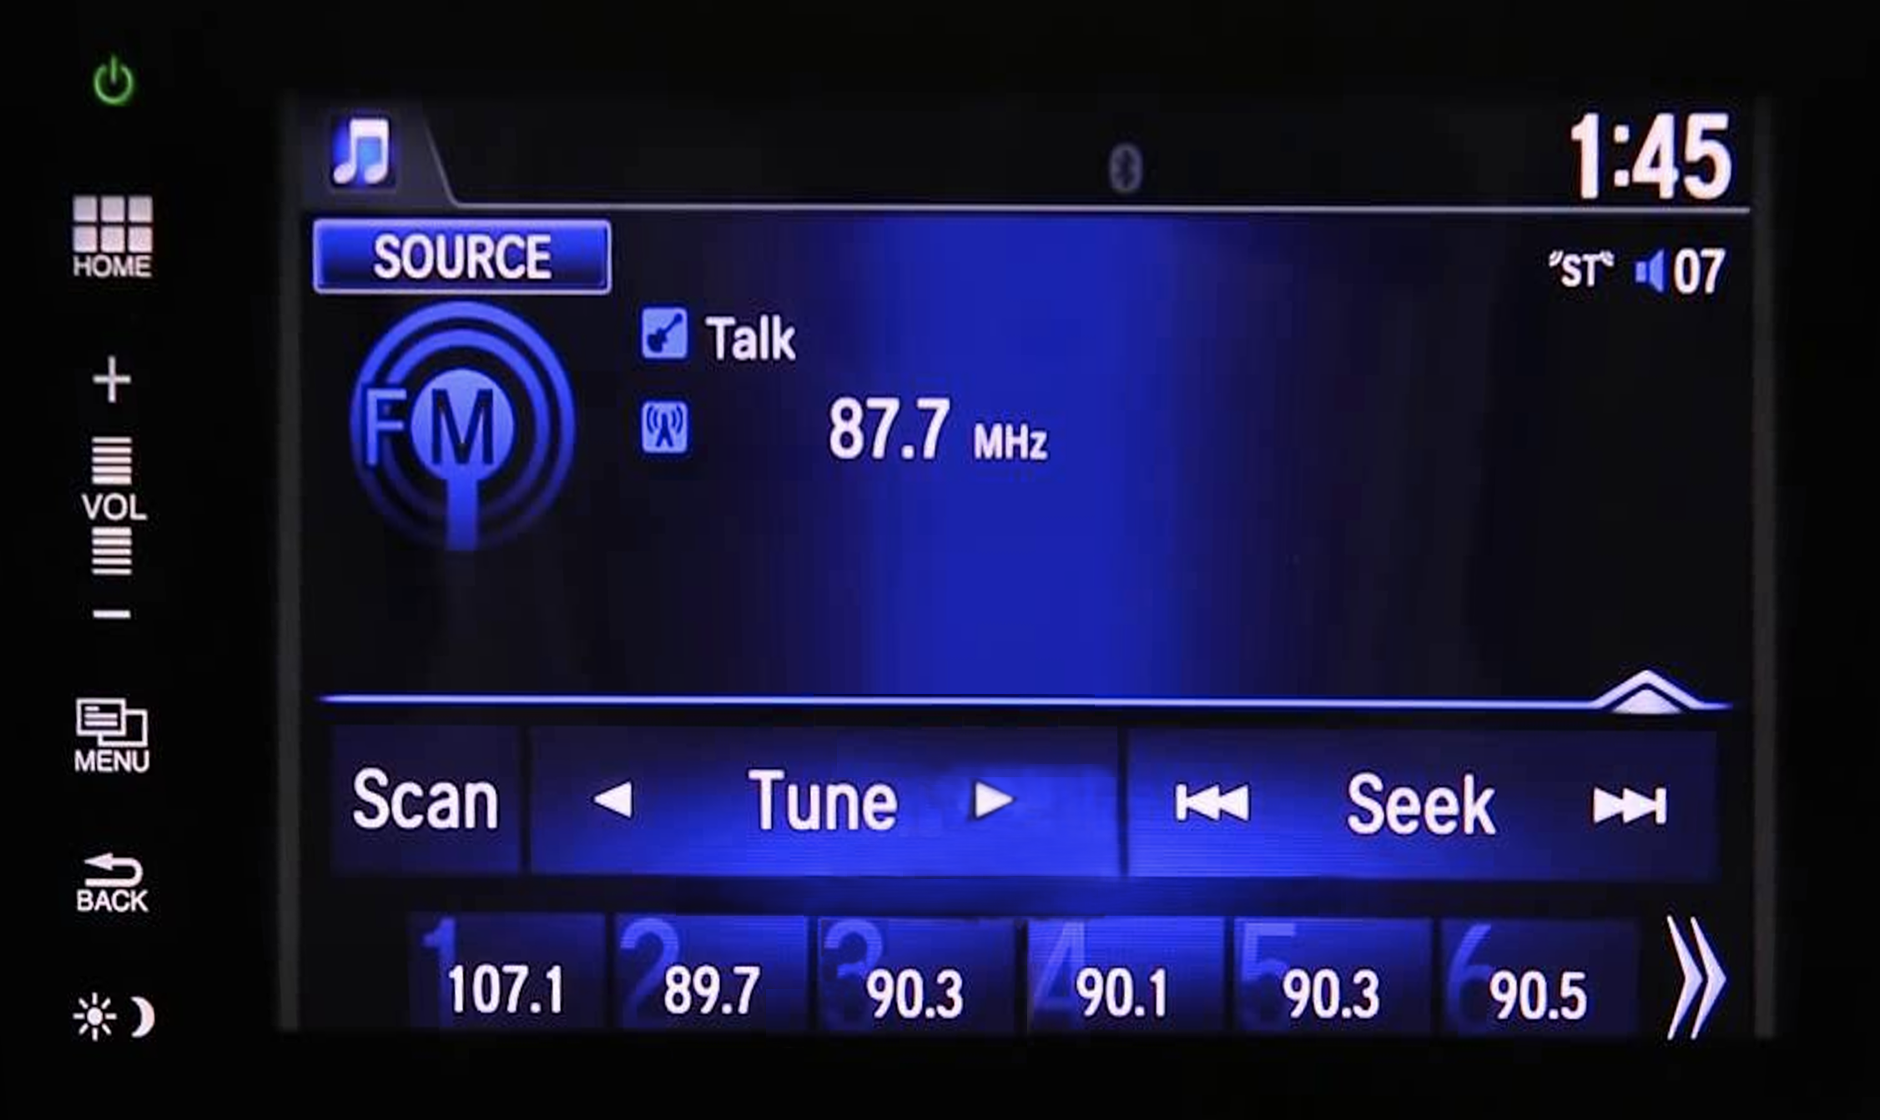
A sample digital cockpit: Called “The Demonstrator”
Instrument cluster
Infotainment and apps
Android Apps
Browser
Multimedia
Navigation
Camera
USB/WiFi/LTE
Bluetooth
Google Automotive Services
QNX screen (graphics)
QNX acoustics
QNX car critical software
QNX Advanced Virtualization Frameworks
QNX Hypervisor
Digital cockpit hardware (ARMv8)
17

Slide 18
Technical Specifications
© 2022 BlackBerry Limited. All Rights Reserved.
18

Slide 19
Foundational Virtual Devices: Provided by the QNX Hypervisor
DEVICE/SERVICE | DESCRIPTION | HARDWARE PLATFORM | INDUSTRY VERSION/COMPATIBILITY
qvm: Virtual Machine | Virtual machine manager. Supports virtual CPUs and memory mappings for guest. | X86_64+ARMv8 | QNX
GICv2 | Interrupt controller | ARMv8 | ARM spec
GICv3 | Interrupt controller | ARMv8 | ARM spec
MC146818 | Realtime clock | X86_64 | Intel spec
8259 | X86 legacy PIC | X86_64 | Intel spec
HPET | High Precision Event Timer | X86_64 | Intel spec
IOAPIC | Intel Advanced PIC (interrupt controller) | X86_64 | Intel spec
PC_Keyboard | PC keyboard emulator (used for ctrl-alt-del) | X86_64 | Intel spec
PL011 | UART | ARMv8 | ARM spec
8250 | UART | X86_64+ARMv8 | Chip spec
Shared memory | Shared memory device | X86_64+ARMv8 | QNX
SMMU | System Memory Management Unit device for QNX guests | X86_64+ARMv8 | QNX. Requires host SMMU service (X86 or ARM)
8254 | Timers | X86_64 | Intel spec
VIRTIO block | Block device used for filesystem access | X86_64+ARMv8 | VIRTIO 1.2 including packed virtqueues
Qualcomm ICE | In-line Cryptographic Engine for block access | ARMv8 | Qualcomm
VIRTIO net | Network device | X86_64+ARMv8 | VIRTIO 1.2 including packed virtqueues
VIRTIO console | Console device used to buffer streaming devices | X86_64+ARMv8 | VIRTIO 1.2
SP805 | Watchdog device | ARMv8 | Chip spec
IB700 | Watchdog device | X86_64 | Chip spec
PCI | PCI support for guest | X86_64+ARMv8 | Chip spec
Entropy (RNG) | Random Number Generator | X86_64+ARMv8 | VIRTIO 1.2
Debug/progress virtual device | Debugging device / virtual machine execution progress | X86_64+ARMv8 | QNX
Tracing virtual device | Tracing device for debugging | X86_64+ARMv8 | QNX
Host to guest networking | Network device for QNX hypervisor host | X86_64+ARMv8 | VIRTIO 1.2
19

Slide 20
QNX® Advanced Virtualization
QNX ADVANCED VIRTUALIZATION FRAMEWORKS (ANDROID)
SHARED GPU AND DISPLAY | VIRTIO 1.2.5.7 GPU DEVICE
Shared surface | Extends ‘Shared VPU and Display” to allow Android guest to display in QNX host
Virtual socket | VIRTIO 1.2.5.10 socket device
Shared input | VIRTIO 1.2.5.8 input device
Shared audio | VIRTIO 1.2.5.14 sound device – Includes System Wide Audio Management service (SWAM)
Shared video and camera | Supports ‘virtio-video’ as defined by latest technical committee draft. This specification is not yet approved
Shared USB | No standard exists. Allows allocation and use of USB devices by guest OS or hypervisor host
Sensor sharing | No standard exists. ‘virtio-scmi’ is proposed. Allows abstraction of a select set of Android HAL devices back to applications running the QNX host (e.g. Inertia Management Unit)
Shared filesystem | No official standard exists. Community standard only. ‘Virtio-fs’ is proposed. Allows guests to share the same host-based filesystem for read/write access using FUSE
QNX guest graphics sharing | No standard exists. Allows a QNX guest to render to a display controlled by the hypervisor host using virtio-gpu
Virtual Bluetooth | No standard exists. Virtualization of Bluetooth device from Android to hypervisor host
Linux guests supported separately
20

Slide 21
Developing with graphics
Virtual machine
Virtual machine
QNX graphic applications
Android/Linux graphic applications
QNX guest microkernel
Virtual graphics/ SwiftShader
Guest kernel
SurfaceFlinger, GfxStream, Virgl, ANGLE, SwitchShader
OpenGL ES 2D/3D
virtio-gpu
virtio-gpu
QNX graphic applications
Graphics driver
Vulkan 1.2
VK_QNX_screen_surface
Hypervisor host
Host: QNX Microkernel
OpenGL ES, Vulkan programming in QNX Host and Android/Linux guest and cloud is moving towards a common build environment with no hardware specifics
OpenGL is a registered trademark and the OpenGL ES logo is a trademark of Hewlett Packard Enterprise used by permission by Khronos.
Vulkan and the Vulkan logo are registered trademarks of the Khronos Group Inc.
The Android robot is reproduced or modified from work created and shared by Google and used according to terms described in the Creative Commons 3.0 Attribution License.
21

Slide 22
Example Virtual Device: Abstraction and Sharing of Audio: virtio-snd
Android hypervisor guest
Apps
virtio-snd
Multiple audio playback and capture channels presented to guests
Software mixers in host that can combine audio playback from guests and host
Software splitters
Supports Class 1, 2 and 3 audio for guest (one to one, transient and many to one)
Supports Audio Control HAL for Android (emit emergency chimes outside of Android)
Linux hypervisor guest
AudioFlinger
QNX hypervisor guest
Apps
AudioHAL
Apps
ALSA
TinyALSA
Audio Resource Manager (io-audio)
Linux Kernel
Linux Kernel
virtio deva driver
virtio sound driver
virtio sound driver
virtqueues/shared mem
virtqueues/shared mem
virtqueues/shared mem
QVM
QVM
QVM
virtio sound vdev
virtio sound vdev
virtio sound vdev
Audio resource manager (io-audio)
QNX Hypervisor host
hw deva drivers
22

Slide 23
How QNX team can help
QNX Hypervisor host environment
EXAMPLE 1 vehicle_server program provides vehicle data to apps running in guest
Virtual machine environment
Guest environment
3
4
Custom
front ends
Custom
back ends
AND
1
Custom kernel modules
EXAMPLE 2 A custom front end is developed to exchange vehicle data with drivers in backend as an extension to VIRTIO. May involve kernel module.
2
Custom applications | Guest drivers/stacks
5
Custom services
23

Slide 24
Futures
QNX ACTIVE IN SERIES TO EXTEND VIRTIO
Encoding of video
System-wide audio management
WORKING WITH HARDWARE PARTNERS ON NEXT GENERATION SOFTWARE DESIGN
E.g., Qualcomm GEN4 (82XX and others)
CONTINUING TO ADD TO OUR SAFETY-CERTIFIED PORTFOLIO WITH VIRTUAL DEVICES AND SUPPORTING BACKEND SOFTWARE
E.g., using safety-certified filesystems with safety-certified virtio device
Updates to Android (13) and Google Trout Configuration (1.1/1.2)
Linux 5.X kernels
Working with security teams to ensure we are meeting future requirements
24

Slide 25
Thank you
25

