Slide 1
The Industrial Software
Revolution and Functional Safety –
Designing with QNX Safety Products
Louay Abdelkader
Product Manager
Notes:
BACKGROUND
The purpose of this presentation
This presentation is intended for an in-person or virtual session between a member of our Sales team and key decision-makers within a targeted OEM.
It ensures we tell our story with a consistent and up-to-date narrative.
The intended outcome is a set of next steps with a view to, for example, an executive sponsorship of a proof-of-concept or similar activity, allowing us to demonstrate our capabilities, and thus potentially lead to new business.
It is not death by PowerPoint ☺
How it works
The presentation starts off with defining the business challenges in the industry, around achieving the Software-Defined Vehicle (SDV), that keep ‘keep OEMs awake at night’.
We then show how these challenges place numerous demands on OEMs – with the key message that to meet the demands, software and development processes are becoming increasingly complex.
Our narrative then walks through each business challenge, one by one at a high level, showing how we address by our product portfolio.
The purpose up to this point is to demonstrate to the OEMs that we understand the dynamics of the industry. We’re not talking at them nor lecturing, and we can’t come across that way! The point is to get some heads nodding at certain business challenges.
This should take about of 15 min of presentation – 10 slides or so. Done.
Then crucially, we pause and ask “Let’s talk about your business challenges and next steps on how we could help” – this is key to the next part – a two-way discussion.
The remaining slides are optional – they allow the Sales team member to use her/his judgement and choose where to go, in a bit more detail, depending on what’s resonating with the OEM, to reinforce points, answer/take away questions, talk about our success etc.
The intent for this open-conversation is 45min, making a one-hour meeting in total.
A concrete set of actional next steps should be agreed to before the session ends.
Living document
Our narrative and associated messaging will subtly evolve as we go forward, for example, in cloudification we’re developing solutions to be announced in due course
Therefore, it’s expected that we’ll put out an updated version of this deck every 2-3 months. Product Marketing will push this out to the Sales team and advise of changes.

Slide 2
Agenda
Future of the industrial market
Functional safety for the industrial market
Operating system as the foundational piece
QNX safety offerings
Notes:
Automation
Connectivity
Affects
Transportation
Life-sciences

Slide 3
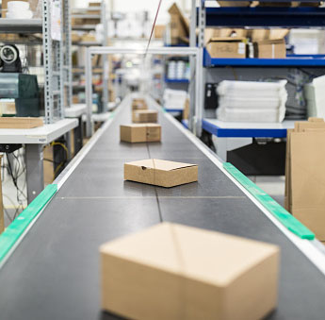
Where is the industrial market today?
TODAY – INDUSTRY 4.0
Digitized factories
Automation
Robotics
Cloud computing
Internet of Things
Data Analytics
Artificial Intelligence
TOMORROW – INDUSTRY 5.0
Notes:
Becoming digital is no longer an option – it’s a requirement. The market today is as complex as any time in history – increasing customer demands, rapidly changing customer preferences and the emergence of new supply channels are all putting enormous pressure on manufacturers.
Digital experience/reality assisting the workforce in tasks such as design or remote support
Data analytics and artificial intelligence to predict and augment decisions from assembly operations to material movement
Distributed platforms to run the ML/AI in the location that best optimizes the cost and computation needed for the data connectivity in support of those systems
Automation opportunities through the deployment of traditional robots, collaborative robots, and drones will make teams more productive and safer

Slide 4

Growth drivers and challenges
GROWTH DRIVERS
Legacy systems upgrades
Increased demand for software-based updatable systems
Growing need for sensor integration
Increased desire for automation and task support
Increased desire for performance at the edge
Growing adoption for artificial intelligence and machine learning
CHALLENGES
Design complexity
Functional safety
Cybersecurity
Notes:
What are the growth drivers and some of the challenges for the general embedded market?
We have list what we consider the top 8 drivers including smart homes, military, medical, automotive and industrial applications where embedded systems are becoming increasingly interconnected via IoT and automated.
We have identified the top 3 challenges for achieving these new functions. Firstly, the significantly complex design for embedded systems which is moving towards system consolidation on a single system on chip. Secondly Security management due to the fact that embedded systems are becoming increasingly interconnected and will have internet access which increases the entry points of attack .
Lastly is functional safety. This is due to the fact embedded systems are now interacting more and more directly and indirectly with the surrounding environment including people which makes this the functional safety aspect of the underlying software becomes increasingly vital. the last thing you want is for your software to accidently harm anyone around it.
We are going to primarily focus on the functional safety aspect of embedded software in this discussion which for a 1 hour webinar is going to be tight but we will provide you with enough detail to make think about functional safety of software differently and holistically. if we tried to talk about all 3 challenges in detail it would be more like a week long webinar.

Slide 5



Components of Industry 4.0
Suppliers
Manufacturing
Customers
SMART SUPPLY NETWORK Transparency over supplier inventories allow for automatic and optimized supply decisions
NEXT-GEN MANUFACTURING SYSTEMS Manufacturing systems make automated and smart decisions (e.g., production scheduling), offer intelligent machine applications, seamless engineering integration and allow for remote visualization, monitoring, control and alters
RESPONSIVE MANUFACTURING Individual manufacturing steps are designed for customer interaction so that products can be tailor-made for customers
Software
CLOUD STORAGE/PROCESSING Data storage and application processing on secure cloud servers
DATA ANALYTICS Advanced decision algorithms and real-time analytics
CYBERSECURITY Encrypted data and protection mechanisms against cyber threats
INTELLIGENT SENSOR/ACTORS Data storage and application processing on secure cloud servers. Sensors deeply integrated in machines wirelessly stream data and have an own analytics engine (edge analytics)
CYBER PHYSICAL SYSTEMS Interconnected systems and social machines control physical entities
SMART MAINTENANCE Machine maintenance becomes integrated (autonomous) aided by predictive algorithms and remote assistance systems
MOBILE WORKFORCE Workers are equipped with mobile devices and augmented reality devices to process real-time information
SELF-DRIVING VEHICLES Material is handled via autonomous vehicles and intelligent transportation units
INTELLIGENT PRODUCTS Products carry relevant information for machines to make decisions
ADDITIVE MANUFACTURING 3D printing allows for rapid prototyping and rapid spare part printing
ROBOTICS Use of flexible robots' augments intelligence, automates certain processes and creates new forms of worker-robot interaction
ADVANCED MATERIALS New materials such as nano-materials as well as integrated computational materials engineering (ICME)
IoT-related
Shop floor
Not IoT-related
Notes:
https://iot-analytics.com/industrial-internet-disrupt-smart-factory/
If we look at the components of smart factories of the future, we divided them, into IoT related and non IoT related. But as you can see automation, smart decisions and sensor integration are the core of it of the new products that will be used in these facilities like robotics. That means the embedded systems that were generally used at manufacturing facilities before have to drastically evolve on both the hardware and software side to support these intended functions. That means that big part of the development of these systems is to ensure that they are considered Functionally safe. The last thing we want is for a self driving car hitting a wall or worse hitting a worker due to faulty software or an edge case

Slide 6
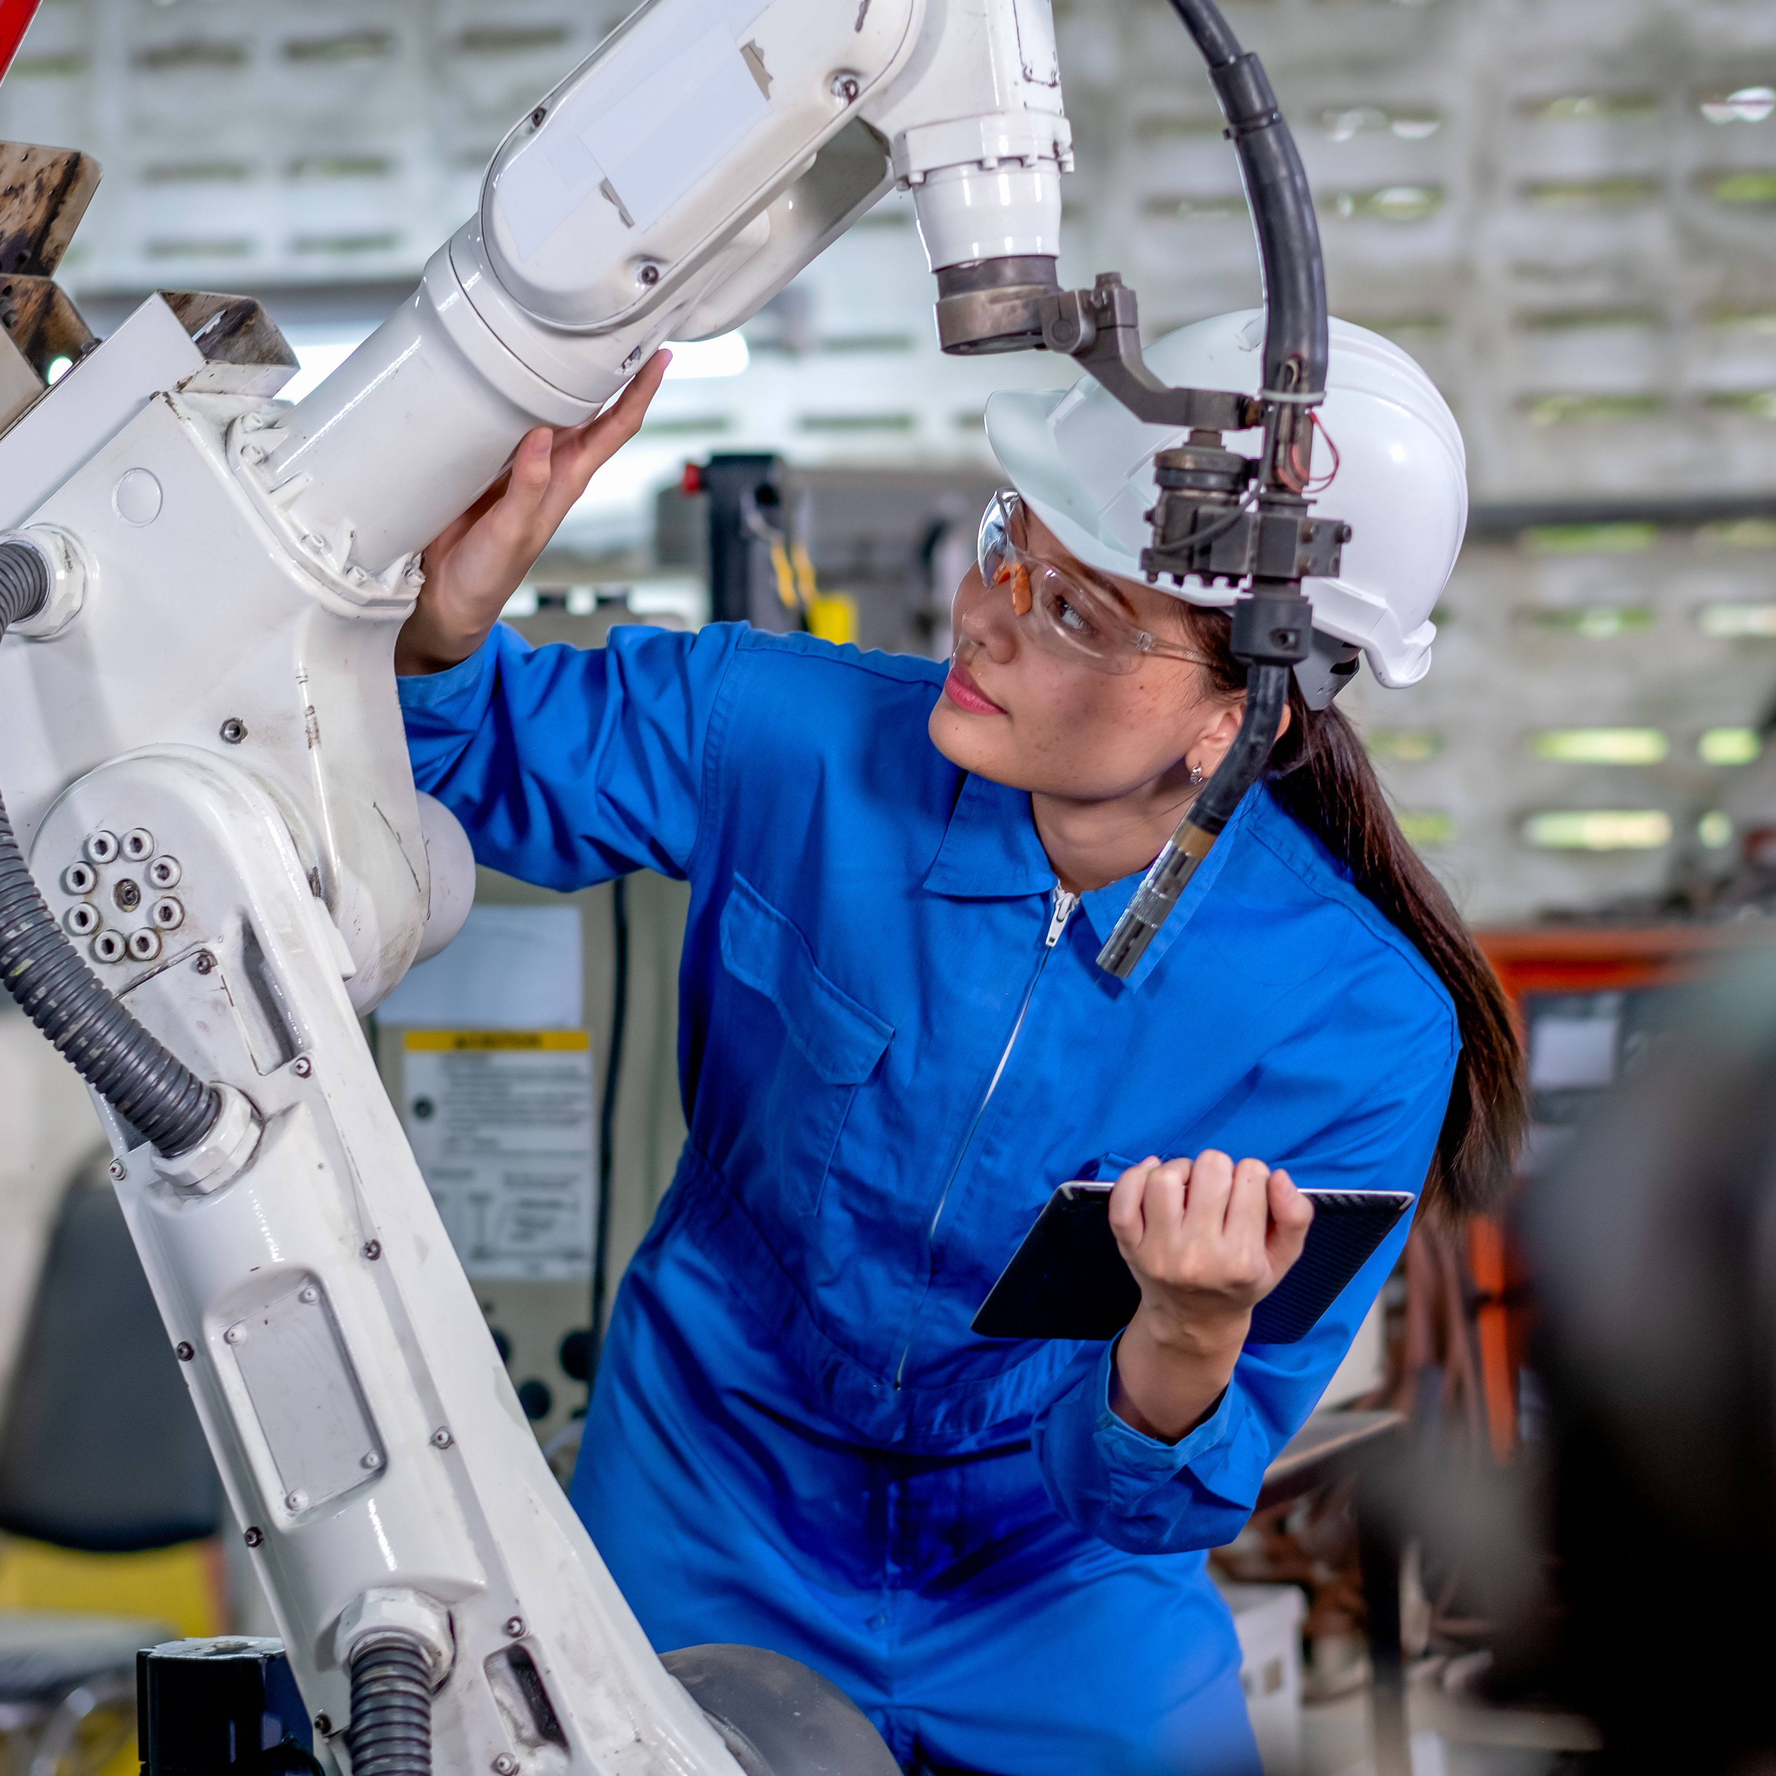
The future – Industry 5.0
IT COMPLEMENTS INDUSTRY 4.0 WHILE FOCUSING ON THE FOLLOWING OBJECTIVES:
Human and machine cooperation
Human intelligence working in harmony
with cognitive computing
Fully autonomous robotics
Modern, resource-efficient and sustainable industries
Rapidly growing demand for wearable devices
Notes:
The term Industry 5.0 popped up several years ago as a reaction to the vision of Industry 4.0. Driven by the impact of the pandemic, the focus on topics such as sustainability and resilience, and the call to put people more central again, it has become a subject policymakers and organizations increasingly pay attention to.

Slide 7

Why is functional safety important?
SAFETY IS IMPORTANT BECAUSE LIVES AND REPUTATIONS ARE AT STAKE
Notes:
https://www.themanufacturer.com/articles/uk-industrial-robots-installations-increase-third-year-row/

Slide 8

What is functional safety?
EVER-GROWING DEMAND FOR EMBEDDED SYSTEMS TO PROVIDE:
Internal fault protection
External interference protection
Automatic corrective action in response
of hazardous events
FROM THE STANDARD: “Functional safety is the part of the overall safety of an electronic system or piece of equipment that depends on automatic protection operating correctly in response to its inputs or failure in a predictable manner.”
Notes:
Which brings us to the functional safety standard.
What is functional safety you might ask, well it’s defined as “the part of the overall safety of a electronic system or piece of equipment that depends on automatic protection operating correctly in response to its inputs or failure in a predictable manner.”
They’ve emerged from a demand for detection of potentially dangerous conditions in electric, electronic and programmable electronic safety-related systems. That detection can either lead to the activation of a protective measures, corrective action to prevent hazardous events arising or provide mitigation to reduce the consequence of the hazardous events.

Slide 9
Functional safety standards
Process driven
IEC 62304
MEDICAL
TECHNIQUE TO PROCESS ORIENTED
EN 50128/50657
RAILWAY
ISO 26262
AUTOMOTIVE
IEC 61508
INDUSTRIAL
Technique based
PRESCRIPTIVE TO GOAL-BASED
Descriptive
Safe system design
Notes:
The original Functional Safety Standard for such systems, called IEC 61508, was published 2 decades ago.
It has since been used at the basis for other functional safety standards, which have been adapted to specific “fields”.
And they are not one side fits all, IEC 61508 is prescriptive and calls for specific techniques, while ISO 26262 for automotive is more goal based, EN 50128 calls for independence and role definition and IEC 62304 is more about following your own processes.

Slide 10

What are functional safety standards trying to achieve?
Internal fault protection
External Standards try to eliminate or reduce risk while ensuring the systems have automatic protection mechanisms that respond to faults
when they arise
Functional Safety standards define Safety Integrity Levels (SIL)
SIL only applies to “safety functions” identified by
risk analysis
Goal of safety function is to put equipment into
a safe state, not necessarily increase availability
Strictly speaking, there is no SIL for systems, but only SIL for safety functions
SIL is a way to identify process, architectural and technical requirements defined by the standard
Notes:
So what are functional safety standards trying to achieve. As I pointed out before, these standards recommend a set of practices, methodologies and processes to manage the lifecycle of safety products. This has been the subject of recent BlackBerry QNX webinars, for example those from my colleague Chris Hobbs, so I invite you to look at e-cast and BlackBerry website for such past webcasts.
But for the purpose of this webinar, what I want to highlight is the standards also define safety goals, in the form of safety integrity levels (SIL).
These goals apply to what is called the safety function, or functions (plural). The SIL are applied to the safety function, not necessarily the whole system, based on risk analysis and classification exercises. These are exercises meant to identify the systematic ability of the system to respond to faults, for example using Failure Mode and Effects or Hazard and Risk Analyses. The outcome of such analyses is usually a set of safety requirements that must be fulfilled by design, implementation and verification techniques.

Slide 11
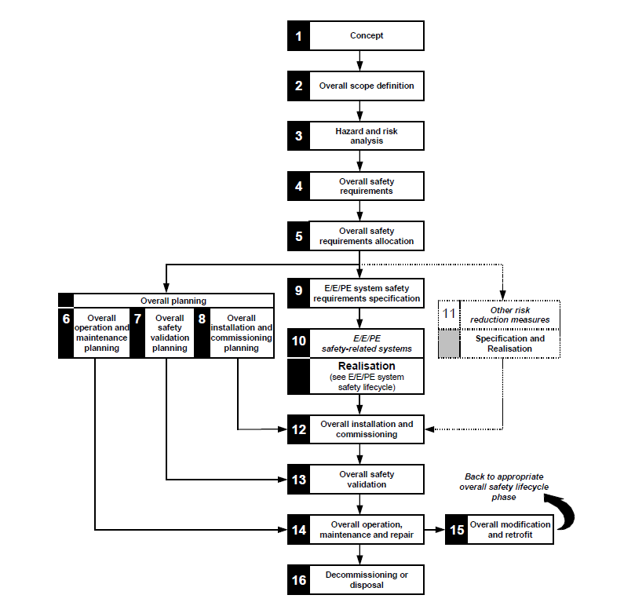
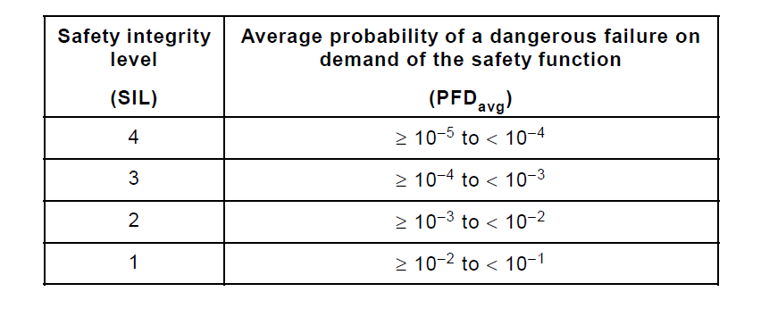
IEC 61508 Functional Safety Standard
Notes:
To be suitable for safety integrity levels, the system must demonstrate it can avoid or control potential systematic failures in hardware and software, as well as control random failures in hardware.
It varies from a standard to another, but it is usually an exercise in measuring confidence in the ability for the system to control systematic fault in hardware and software, or avoid them entirely at the system or software level. The standards define appropriate group of techniques and measures must be used to implement and verify these requirements.
Control of random failures in HW is called by IEC 61508 explicitly, and usually rely on statistical techniques, modeling or historical, to measure the probability of failure on demand and per hour.

Slide 12

Freedom of interference
IEC 61508 PROVIDES REQUIREMENTS
FOR MIXED-CRITICALITY SYSTEM:
"Unless freedom of interference can be demonstrated both in the spatial and the temporal domain ... all of the software
is subject to the highest safety integrity level."
SPATIAL: The data used by one element shall not be changed by another element, in particular non-safety element.
TEMPORAL: One element shall not cause another element to function incorrectly by taking too high a share of the available processor execution time or by blocking execution of the other element.
Notes:
As I alluded to a few minutes ago, the SIL doesn’t apply to the full system, but rather the safety function. However, as stated by functional safety standards in general, it is assumed that all software must be subjected to the highest SIL, unless freedom of interference with the software implementing the safety function can be demonstrated.
This is a very important point, as the subject of today’s discussion is about designing mixed criticality systems, thus the introduction of the concept of freedom of interference measures.
IEC 61508 defines a few freedom of interference measures, 2 specifically relate to the execution environment, that is the spatial (read above) and temporal (read above).
One other form of freedom of interference measure not shown is the slide is the need for communication freedom of interference, and my colleague Louay will speak of this later.
Important to note also that the freedom of interference measures must be implemented according to the highest SIL.

Slide 13
Freedom of interference: Use case
SAFETY FUNCTION
NON-SAFETY FUNCTION
Safety control software
Web browser
Security
Operating system
Tools
Graphics
Filesystems
Kernel
Networking
I/O
Drivers
Network drivers
Motor, brake, etc.
Hardware
ECUs, remote, etc.
GPIO/PWM
Memory Processor
Ethernet
Notes:
We see the embedded operating system as the most important foundational piece for the development of safety software. In this diagram, on the left hand side is shown a simple use case where a control application is used for applying brakes, for example on rail rolling stock, through a GPIO. That application, which implements the safety function, is marked in green along with the components that need to be also implemented according to functional safety standards. On the right hand side is a remote communication application, communicating through TCP/IP and over ethernet to others systems. The components are marked in red as they have no impact on the safety function.
What is important here is to demonstrate that safety components can be hosted in a same execution environment alongside other non-safety components, and that freedom of interference measures must be in place to allow this, so let’s dive into more details on what these measures are.

Slide 14
QNX safety expertise
SAFETY
Broadest safety-certified portfolio
Significant ongoing investment in safety roadmap
Safety-certified custom engineering and training
SCALE
Scalable product licensing
Deeply embedded to complex system pedigree
POSIX compliance and Linux compatability to leverage talent and technology
Safety
Trust
Security
SECURITY
QNX’s software portfolio proven security
Blackberry and QNX brand value and reputation
Blackberry and QNX security services
BlackBerry
QNX
REAL-TIME
Decades of powering critical systems
Real-time OS pedigree and adherence to standards
Best-in-class system performance and tools
Real-time
Reliability
RELIABILITY
Decades of proven reliability in mission-critical systems
Proven microkernel system architecture
Trusted long-term customer support
Scale
TRUST
Trusted to deliver on commitments (100% SOP success)
Impeccable reputation for world’s best engineering talent
Mission – Life – Saftey – Critical foundation
Notes:
When working with BlackBerry QNX you can expect foundational values to bring your projects to success.
In regards to safety, our approach has been to invest in the foundational pieces we’ve talked during this webinar and we have built a broad safety product portfolio.
We have recognized brand value for security and QNX software has state of the art security features.
We have decades of proven reliability in mission critical systems deploying our microkernel.
We have Deeply embedded to complex system pedigree, POSIX compliance and Linux compatibility to leverage talent and technology
Realtime OS pedigree and adherence to standards, Best in class system performance and tools.
We are trusted to deliver on commitments, and we have a 100% start of production success.

Slide 15


QNX safety products holistic view
QNX file system for safety
Safety certifications
IEC 62304
IEC 61508
ISO 26262
EN 50128
EN 50657
Certified C++ library
QNX Black Channel Communications technology
QNX Hypervisor For Safety
QNX Operating System For Safety
QNX software development tools
BlackBerry QNX professional services

Slide 16
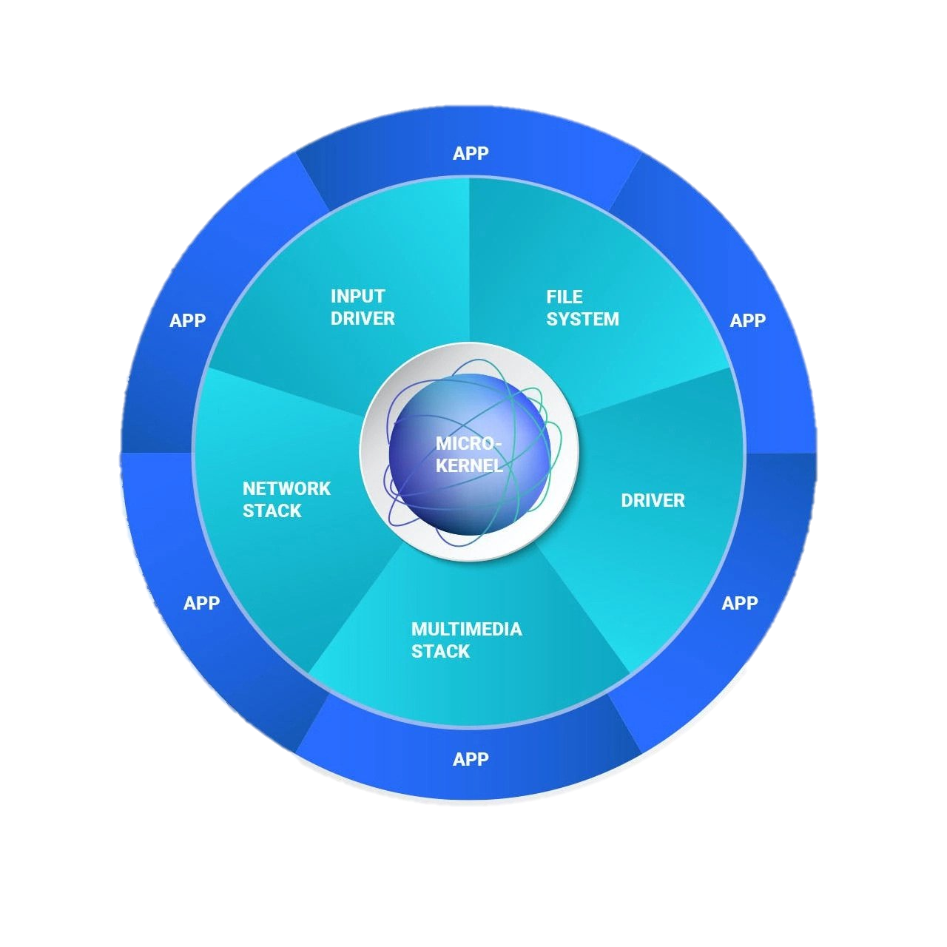
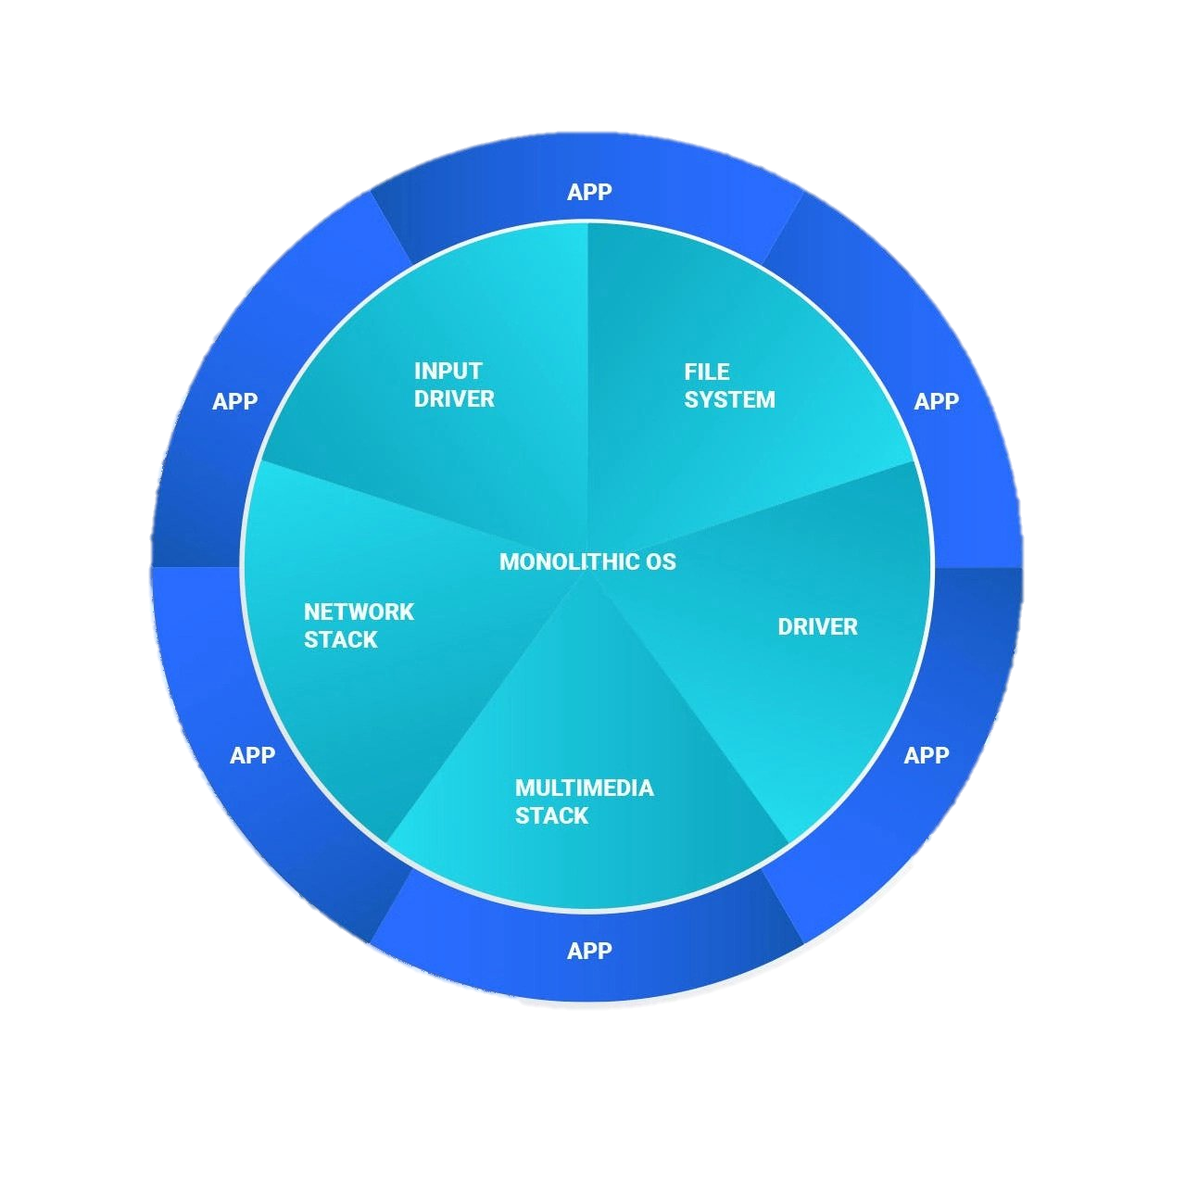
Simplifying complex designs with QNX
SPATIAL SEPARATION Separates the kernel and critical components into their own memory partitions and context, using hardware memory protection.
SPATIAL SEPARATION The kernel and several components share the same execution context, exposing the kernel and critical components to possible corruptions.
QNX Microkernel
Monolithic
MESSAGE PASSING Unidirectional interfaces such as messages or pipes are used to exchange between components, limiting possible corruption of critical messages.
MESSAGE PASSING Relies on a shared context and shared memory structures between kernel services.
SERVICE RECOVERY Recovering components may require a reboot.
SERVICE RECOVERY Can restart any components individually, without interrupting the kernel.

Slide 17




QNX OS safety measures
TEMPORAL SEPARATION The adaptive partitioning scheduler (APS) supports time partitions to limit CPU usage from misbehaved or rogue applications or services.
BUS MASTER CAGING SMMU support and bounding of memory accesses by bus-mastering device, prevents unintentional or malicious access to safety-critical memory.
SPACIAL SEPARATION The microkernel architecture separates critical OS components into protected memory partitions, unlike a monolithic OS that places them all together.
VIRTUALIZATION Allows multiple OSs to run inside virtual machines and provides freedom from interference between guests and host and to implement a local Design Safe State (DSS).

Slide 18


QNX Hypervisor for Safety
VM
VM
BUILT AS AN EXTENSION OF THE PROVEN QNX OS FOR SAFETY MICROKERNEL
BUILD REUSABLE SYSTEMS THAT
SCALE FROM…
A small and efficient hypervisor that supports multiple isolated guest operating systems (acts as separation kernel).
TO
Selective sharing of devices to precisely virtualize Linux and Android systems using standards, such as VirtIO.
TO
Full-featured hypervisor environments that support advanced sharing frameworks (graphics, audio, touchscreens, streaming media); blending Android and Linux alongside a real-time hypervisor host.
BUILT AS AN EXTENSION OF THE PROVEN QNX OS FOR SAFETY MICROKERNEL
The hypervisor leverages the security, performance, real-time and reliability of trusted QNX operating system running as the hypervisor host.
QNX Hypervisor for Safety is
pre-certified to IEC61508 SIL 3.
SIL 3
SIL 0
OS
OS
QNX Hypervisor for Safety
Hardware

Slide 19
Want to dig deeper into functional safety?
The safety experts at BlackBerry QNX have two learning options to help you on your journey.
ONLINE COURSE – INTRODUCTION TO FUNCTIONAL SAFETY This five-part introductory course covers the basics of functional safety as it applies to embedded system design and can be customized to focus on specific industry standards. Groups of up to 20 people can attend | Five 90-minute sessions
CUSTOM WORKSHOP FUNCTIONAL SAFETY WORKSHOP This fully customized and interactive discovery workshop is delivered virtually. BlackBerry QNX product and safety experts will facilitate a system design review and outline relevant safety products and processes to help you on your certification journey.
Visit blackberry.qnx.com/en/professional-services/services-overview for more details
Notes:
So if you want to dig deeper into functional safety, please feel free to visit our website or consult a QNX sales representative.
The safety experts at BlackBerry QNX know the unique challenges of embedded systems and the effort and costs of certifying them.
We’ve built courses based on that expertise, starting with an introduction to Functional Safety that covers the basics as it applies to embedded system design and can be customized to focus on specific industry standards.
We also have a Functional Safety discovery workshop, where our safety experts will facilitate a system design review to identify the safety function and the safety goal of your system, outline relevant safety products and processes and help you on your certification journey.
Both workshop can be carried virtually, and split into a few short sessions.

Slide 20

What else does the future hold?
Source: http://www.cartoonistgroup.com/store/add.php?iid=169867
Notes:
I hope this webinar was a useful introduction to functional safety in regards to mixed-criticality systems, and we are ready to answer any questions that you might have in a short Q&A session for the remainder of this webinar.

Slide 21
Thank you

