Slide 1
Reducing Vehicle Data Costs and Increasing Software
Development Efficiency – BlackBerry IVY™
Tarun Shome
Product Management Director,
IVY Ecosystem
Notes:
Hello welcome all,
My name is Christ H and I am a Technical Product Manager at Blackberry QNX working on the Cloud enablement for embedded development
The presentation will be approx. 15 min during which we’ll outline today’s automotive business challenges and how we address each with our product portfolio.
During this, please think about which of these resonate most with you.
We’ll then discuss those specific ones, and we can go into more detail.
What we would like to come away with today, is an actionable set of next steps, whereby we can demonstrate to you the value we can bring. We are seeking, for example, a sponsorship of an activity such as a proof of concept.

Slide 2
BlackBerry IVY overview
BLACKBERRY IVY™ IS AN INTELLIGENT IN-VEHICLE SOFTWARE PLATFORM, WITH CLOUD-CONTROLLED ACCESS TO VEHICLE DATA THAT PROVIDES AUTOMAKERS THE ABILITY TO:
Securely generate insights at the edge
Share insights consistently with a global digital ecosystem at scale
Insight ingestion on or off the vehicle with ML
BLACKBERRY IVY PROVIDES AUTOMATERS:
Accelerated development time
Reduced telemetry and data cost
Complete control over stack (No vendor lock-in)
100% ownership of data
Access to a broader developer community
BlackBerry IVY platform
INTEGRATE
Deploy BlackBerry IVY middleware to cockpit, gateway, ADAS or others
Connect, normalize, and transform vehicle sensor data
Hardware & OS agnostic
CREATE
Develop and test synthetic sensors, intelligent vehicle data analytics and ML
Easy to use APIs & SDKs for multiple languages
Consistent across vehicle makes, models and brands
DEPLOY
Plan, deploy, update and monitor insights from IVY™ Console in the cloud
Easy life cycle management for entire life of vehicle
COMPUTE
Synthetic sensors created by OEMs and ecosystem partners run in-vehicle and generate actionable insights
Leverage the hardware in the vehicle
SHARE
Share insights to power in-vehicle and cloud-based applications and experiences
Send insights to OEM IT landscape
Cloud agnostic
Notes:
-

Slide 3
BlackBerry IVY overview
BLACKBERRY IVY SAFELY ACCESSES VEHICLE DATA AND PROCESSES IT USING MACHINE LEARNING TO GENERATE “INSIGHTS” TO ENABLE NEW SERVICE OFFERINGS AND CUSTOMER EXPERIENCES
Raw vehicle data
In-vehicle edge processing
via machine learning
Drive new service offerings and customer experiences
Occupancy
Driving dynamics
Synthetic sensor #1
Synthetic sensor #2
Synthetic sensor #3
New subscription services
Enhanced driving experiences
ADAS
Synthetic sensors are in-vehicle (edge) algorithms that process multiple raw signals to analyze for specific behaviour in the vehicle via BlackBerry IVY to generate shareable insights used by applications. For example, occupants detected, driver style, personalization, feature utilization, location awareness, battery range.
Reduce connectivity and cloud costs
Reduce warranty expenses
Location
EV / Powertrain
Stability
Control

Slide 4
BlackBerry IVY platform
Other Cloud Providers
&
Cloud
On-premise
OEM telemetry
IN-VEHICLE
OEM IT LANDSCAPE
Data Lake
ML
Digital Twin
Data consumers
Apps
Local applications
OEM connectivity
APIs
IVY EDGE
SYNTHETIC SENSOR SERVICES
Locally process with updatable code and share vehicle Insights
IVY CONSOLE
IVY DEVELOPER TOOLS
CLOUD CONSOLE
The interface for OEM deployment, control and monitoring of the IVY™ Edge
SDKs/APIs
Code creation and
submission portal
VEHICLE SERVICES
Safely access vehicle data and
abstract away complexities
APIs
DOCUMENTATION
OEM, Tier 1 and
developer support
IVY Console
communications
VEHICLE HARDWARE AND OS
CLOUD SERVICES
The underlying services supporting deployment, control and monitoring
EMULATION AND SIMULATION
Vehicle simulation and
model tuning
VEHICLE DATA AND SIGNALS

Slide 5
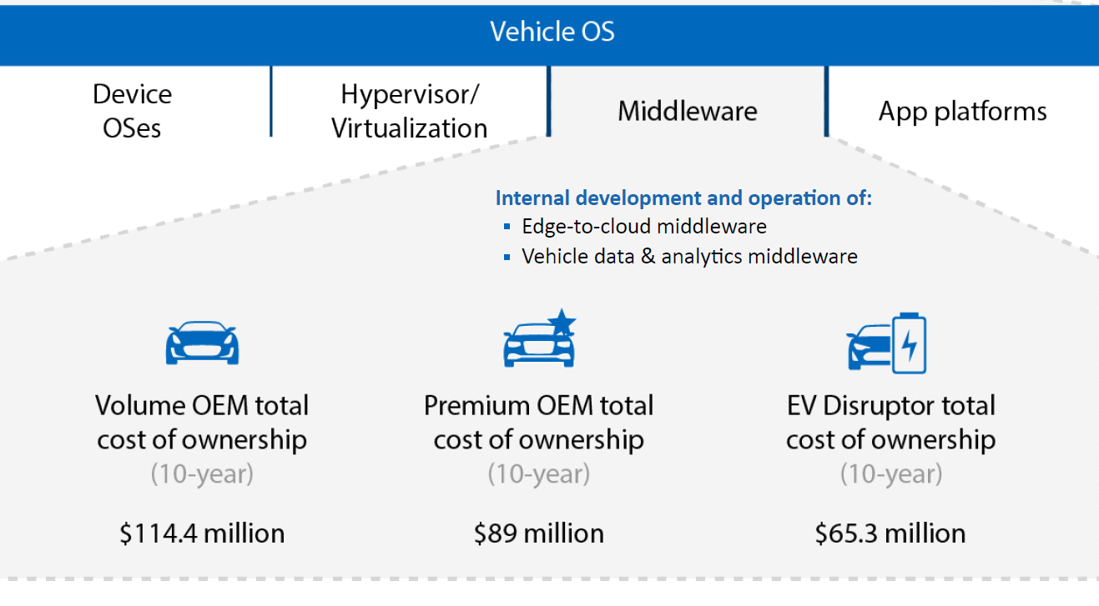
The costs of the software-defined vehicle
Connected middleware can comprise a large portion of a Premium OEM’s total software budget - $89M
But this is only half the story…
As it is estimated that ~50% of additional expenses will be incurred via operational and support costs¹
¹
¹Source: SBD, 2021. The Hidden Costs of Software-Defined Vehicles. [Online]
Available at: https://www.sbdautomotive.com/post/white-paper-the-hidden-costs-of-software-defined-vehicles
2

Slide 6
BlackBerry IVY is stronger with our partners
BUILD ONCE AND DEPLOY ON MULTIPLE PLATFORMS
BlackBerry
IVY
(Middleware)
Usage-based
insurance
Analytics/
diagnostics
EV/battery
management
Payments
Vehicle platform #1
Location-based
services
Connectivity
Vehicle platform #2
Automotive
Fintech
Fleet
Removing the need for multiple integrations
Tier 1s
Consumer
products
Vehicle platform #3
2

Slide 7
BlackBerry IVY as a co-development
REVENUE GENERATION
Supports creation of data powered and vehicle integrated experiences and services that OEMs can monetize with their end customers and partners.
OPERATIONAL IMPROVEMENTS
Empowers data driven decisions and increased visibility through the vehicle life cycle to achieve cost savings throughout the vehicle life.
DATA MANAGEMENT
Added data stream flexibility and access control to support event monitoring, reduced bandwidth cost, and increased local processing ability.
RISK REDUCTION
Provides security and control to more rapidly achieve compliance with global and local regulations for privacy, consent enforcement, and data protection.
Revenue generation
Operational improvement
Data management
Risk reduction
2

Slide 8
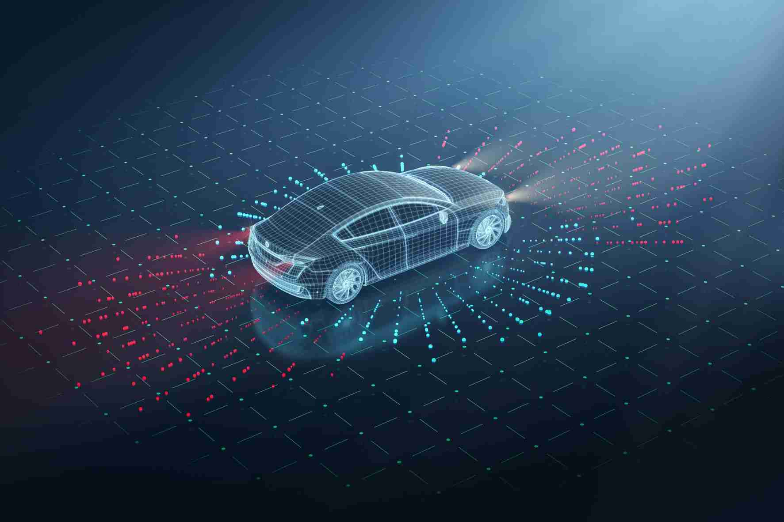
EV state of charge and battery insights
PROVIDE THE BEST CUSTOMER EXPERIENCE FOR ELECTRIC VEHICLE
Raw vehicle data
BlackBerry IVY edge processing
Drive new business and customer outcomes
Deploy models to analyze for specific behaviour directly to the vehicle via BlackBerry IVY
Driver data
Battery
Accurate route calculation
Battery life enhancement
Driving Behaviour
Route Profile
Battery State of Charge
Charging
Ignition
Can I improve my driving style to extend my vehicle range?
Is the current vehicle setting (driving mode, suspension, gear shifting…) optimized for my driving style?
Can environment information (weather, temperature, elevation,…) help to have better range prediction?
Can my vehicle be pre-conditioned while charging to avoid AC/seat heating draining the battery while on-the-go?
Is my battery performing as expected or is my charging patent impacting the battery life?
Data fusion from real-time vehicle data, historical cloud data, navigation, charging providers and others to offer accurate route calculation
Provide driving recommendation, Intelligent charging and fast charge pre-conditioning to improve battery life
Transmission
Location
Tire pressure
BUSINESS OUTCOMES
Reduce customer range anxiety
Increase battery life
New opportunity: smart charging prediction/ infrastructure management

Slide 9
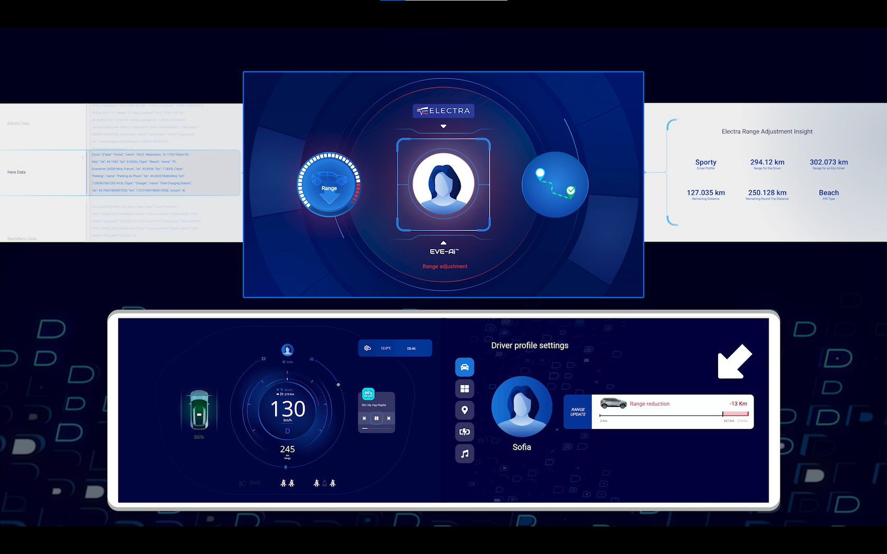
EV state of charge and battery insights demo 2022

Slide 10
Predictive maintenance
EARLY DETECTION OF POTENTIAL FAILURE BASED ON REAL-TIME INFORMATION AND HISTORICAL DATA
Raw vehicle data
BlackBerry IVY edge processing
Drive new business and customer outcomes
In-cabin microphones (vibration/ anomalies)
Deploy models to analyze for specific behaviour directly to the vehicle via BlackBerry IVY
Component life warning
Fleet diagnostics
Driving score
Driving style
Mileage prediction
Component wear
Seat and belt sensors
Odometer
Are vehicle components showing early sign of failure because of intensive use or because of potential design failure?
Is the driver habits leading to potential early maintenance needs?
Can a fleet manager have no downtime for his/her vehicles by predicting maintenance requirement?
Predict components failure based real time data, historical data and driving style of the user
Predict the state of your vehicles to plan maintenance and reduce time spent in the workshop
Transmission
Engine torque/ speed
BUSINESS OUTCOMES
Improve vehicle reliability
Reduce recall and warranty cost
Service subscription: Predict maintenance and offer the best service level for your customers
Spare parts and consumable prediction
Brake sensors
Wheel(s) speeds

Slide 11
In-vehicle payment (e.g., fuelling use case)
OFFER PAYMENT SERVICES DIRECTLY FROM THE VEHICLE
Raw vehicle
data examples
BlackBerry IVY edge processing
Drive new business and customer outcomes
Unique vehicle sensors for authentication
Deploy specific models and services directly to the vehicle via BlackBerry IVY
Facilitate
in vehicle payments
Give fleet managers control over spending
Park Status
Continuous vehicle authentication
Geofence and services locator
Payment authorisation (vehicle transaction profile)
Fuel Level
Ignition
Allow customer to pay for fuel with the minimum of user interaction
Fleet managers can authorise vehicles to pay for particular services
Is the vehicle authenticated?
Is the vehicle low on fuel?
Is the vehicle in the vicinity of a filling station?
Is the vehicle authorised to pay for fuel at this filling station?
Speed
BUSINESS OUTCOMES
Park status
Customer satisfaction
Improve customer convenience
Fuel payments with the minimum of user interaction
Fleet management for payment of goods and services
New business model: service subscription, revenue share
Fuel flap status (Where applicable)
Location

Slide 12
Thank you

