Slide 1

Reducing Complexity and Cost While Improving the Automotive Acoustic User Experience
Brad Hamme
Principal Solutions Architect, Global Acoustics
Notes:
BACKGROUND
The purpose of this presentation
This presentation is intended for an in-person or virtual session between a member of our Sales team and key decision-makers within a targeted OEM.
It ensures we tell our story with a consistent and up-to-date narrative.
The intended outcome is a set of next steps with a view to, for example, an executive sponsorship of a proof-of-concept or similar activity, allowing us to demonstrate our capabilities, and thus potentially lead to new business.
It is not death by PowerPoint ☺
How it works
The presentation starts off with defining the business challenges in the industry, around achieving the Software-Defined Vehicle (SDV), that keep ‘keep OEMs awake at night’.
We then show how these challenges place numerous demands on OEMs – with the key message that to meet the demands, software and development processes are becoming increasingly complex.
Our narrative then walks through each business challenge, one by one at a high level, showing how we address by our product portfolio.
The purpose up to this point is to demonstrate to the OEMs that we understand the dynamics of the industry. We’re not talking at them nor lecturing, and we can’t come across that way! The point is to get some heads nodding at certain business challenges.
This should take about of 15 min of presentation – 10 slides or so. Done.
Then crucially, we pause and ask “Let’s talk about your business challenges and next steps on how we could help” – this is key to the next part – a two-way discussion.
The remaining slides are optional – they allow the Sales team member to use her/his judgement and choose where to go, in a bit more detail, depending on what’s resonating with the OEM, to reinforce points, answer/take away questions, talk about our success etc.
The intent for this open-conversation is 45min, making a one-hour meeting in total.
A concrete set of actional next steps should be agreed to before the session ends.
Living document
Our narrative and associated messaging will subtly evolve as we go forward, for example, in cloudification we’re developing solutions to be announced in due course
Therefore, it’s expected that we’ll put out an updated version of this deck every 2-3 months. Product Marketing will push this out to the Sales team and advise of changes.

Slide 2
Overview
The automotive acoustic experience has become a defining characteristic of vehicle ownership, possibly more now than ever. Acoustic systems include branded and unbranded premium media playback, 3rd party experiences, transducers, wire harnesses, amplifiers, multiple DSPs and or SoCs, and a myriad end user features. We will discuss how QNX has the ability to create and simplify these systems while potentially saving mass and cost with our software solutions.

Slide 3
Complexity is a massive challenge
MODERN AUTOMOTIVE ACOUSTICS
Android Auto
CarPlay
Wake Word
Interior Engine Sound
Wind Noise
Environmental
Noise and Sound
Wipers
Voice Assistants
Bluetooth Handshake
Seatbelt Latch
HVAC Noise
AVAS Pedestrian alerting
Music and Media
Siri &
CarPlay
Car Life
External Engine Sound
Navigation
Alerts and UI Sounds
Horn
Exhaust Sounds
Native Engine Sound
Transmission
Doors & Windows
In-Car Communications
Boom Noise
Tire Noise
Road Noise
Notes:
ACOUSTICS COMPLEXITY IS VERY IMPORTANT BUT CHALLENGING TO SOLVE
The modern vehicle is fitted with many audio, speech and acoustics technologies but it is also subjected to a wide range of different kinds of noise. It is our job as acoustics engineers to bring the power of software to help manage the sonic experience of the car and make it a comfortable, safe and positive experience.
Leading automakers know the power of sound to move their customer.
They take great care to sculpt the sonic character of their vehicles - in everything from the sounds of the horn to the sound of the chimes, along with propulsion sounds and noise reduction

Slide 4
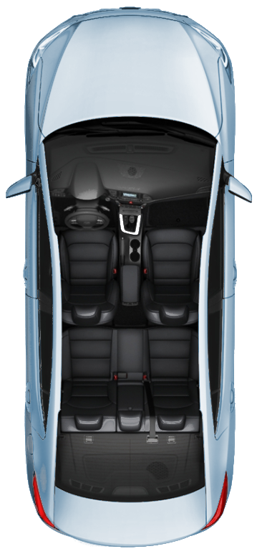

Source
ACOUSTIC SYSTEM
THE SOURCE UNIT, OR HEAD UNIT CONTAINS:
Software (SW)
User interface
User controls
Source (input) control and switching
Audio processing
Hands free
Wiring
Other
Source Unit
Source
unit
4

Slide 5

Playback
ACOUSTIC SYSTEM
THE PLAYBACK SYSTEM CONSISTS OF:
Use of source unit
Multiple systems for base, mid, premium, branded audio
Transducers
Speakers
Microphones
Tactile
Amplifier(s)
Often with DSP and dedicated SW
Mechanical vehicle integration
Digital acoustic tuning parameters
Industrial design (brand dependent)
Additional wiring
Source Unit
Source Unit
Amplifier
Amplifier
Amplifier
Amplifier
5

Slide 6
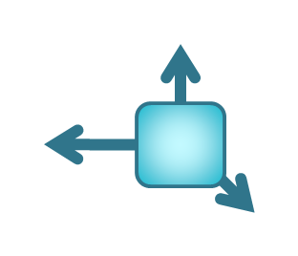
Sound control
ACOUSTIC SYSTEM
THE SOUND CONTROL SYSTEMS SUCH
AS ENGINE NOISE CANCELLATION OR ENHANCEMENT, ROAD NOISE CANCELLATION, IN CAR COMMUNICATION, AND OTHERS ADD:
Use of source unit
Use of transducers
Speakers
Microphones
Tactile
Amplifier and dedicated module
With DSP and additional SW
Digital acoustic tuning parameters
Wiring
Source Unit
Source unit
Amplifier
Amplifier
Amplifier
Amplifier
Sound Control Module
Sound control module
6

Slide 7

Safety
ACOUSTIC SYSTEM
THE SAFETY SYSTEM CONSISTS OF WARNING CHIMES, EXTERNAL NOISE GENERATION, DISTANCE WARNINGS, AND OTHER FEATURES REQUIRE:
Use of source unit
Use of existing and additional transducers
Speakers
Microphones
Tactile
Amplifier or dedicated module
With DSP and additional SW
Additional sensors
Digital acoustic tuning parameters
Wiring
Source Unit
Source unit
Amplifier
Amplifier
Amplifier
Amplifier
Sound Control Module
Sound control module
Safety Module
Safety Module
7

Slide 8
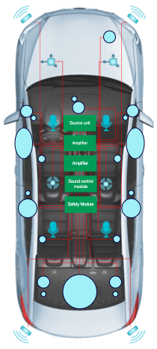
Software
ACOUSTIC SYSTEM
</>
THE SOFTWARE SYSTEM CONSISTS OF MULTIPLE UNIQUE SUB-SYSTEMS OF SOFTWARE:
Each module can have unique SW
Source unit
Amplifier(s)
Sound Control Module
Safety module
Multiple suppliers involved, all with unique SW
All combinations must work seamlessly together
</>
Source Unit
</>
Amplifier
Amplifier
Sound Control Module
Safety Module
</>
</>
8

Slide 9
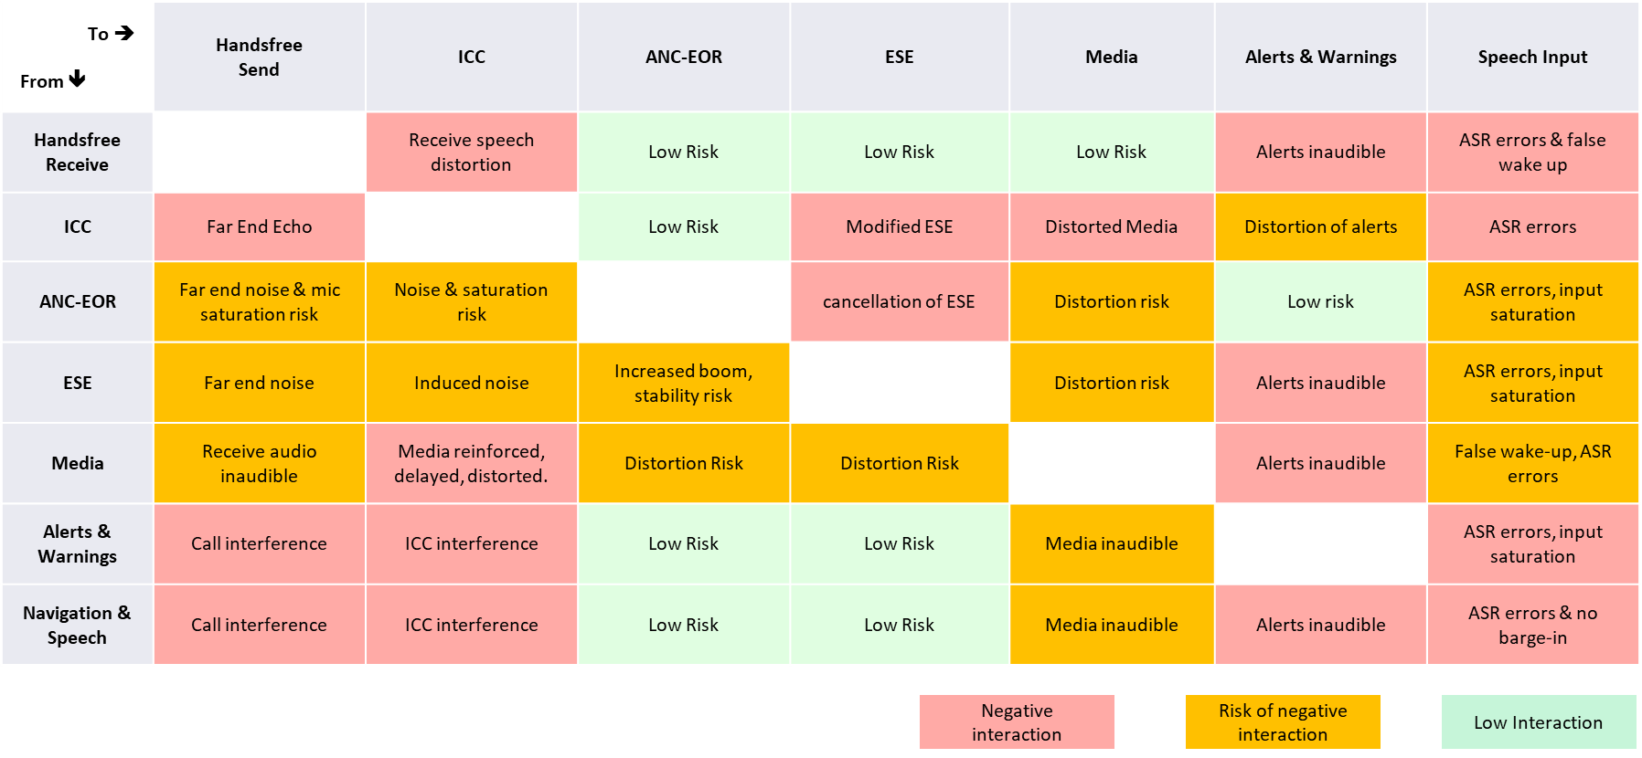
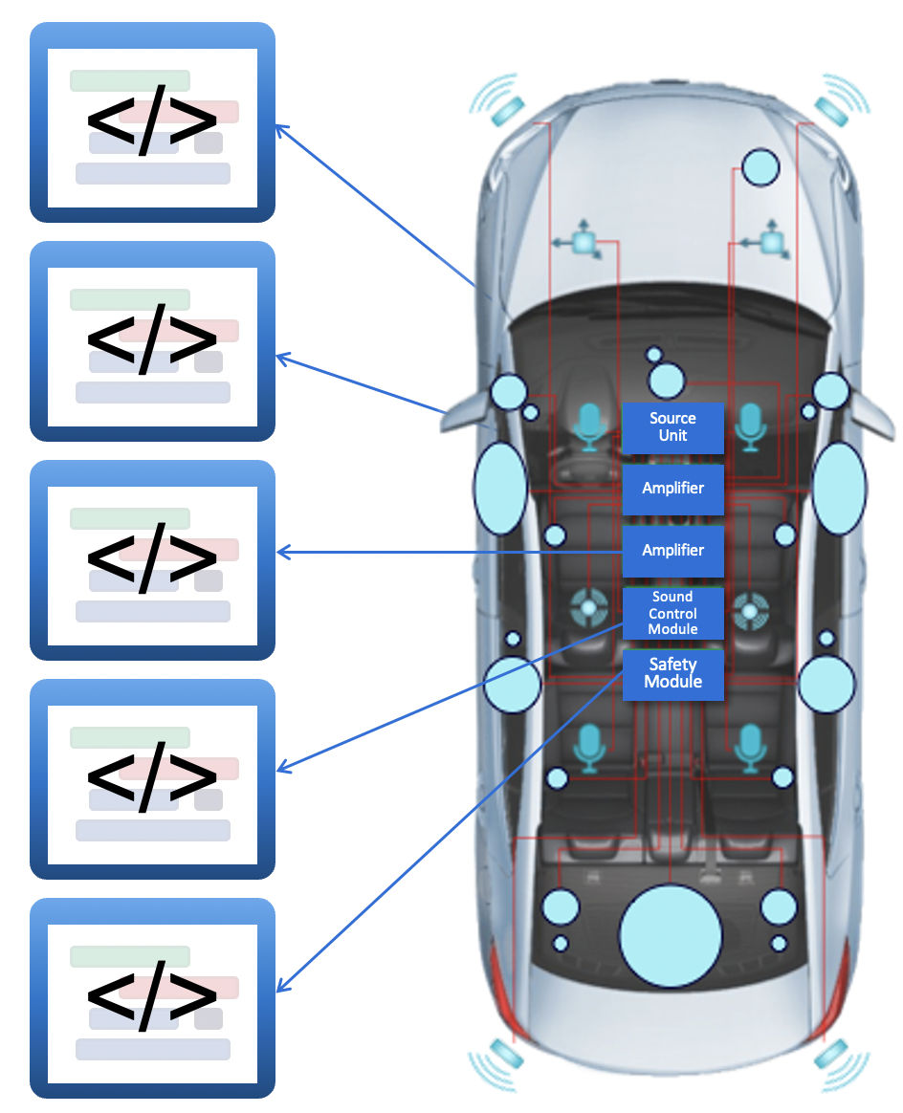
Interaction risks
SOFTWARE SYSTEMS
9

Slide 10
Solution?

Slide 11
Acoustics consolidation
OVERCOMING THE COMPLEXITY
Software from
the engine sound enhancement module
Software from the Smart Amplifier
Software from the Road Noise Cancellation Module
Software from the Media Playback Module
Cluster or
Infotainment
SoC
Notes:
QNX can simplify the complexity of traditional acoustics environments to become more centralized
Here is a new paradigm for managing the acoustics experience within the vehicle

Slide 12
QNX SW solution
ALL SYSTEMS RUN ON SOURCE UNIT USING ALREADY INTEGRATED QNX® SW COMPONENTS
Increased simplification
Eliminate duplication of SW
Reduced wiring
Reduced modules
Reduced mass
Reduced cost
Source Unit
with QNX
Source Unit with QNX
Amplifier
Amplifier
Amplifier
Amplifier
12

Slide 13






QNX® Acoustics Management Platform
SIMPLIFYING THE COMPLEXITY
  Enables new end user experiences through SDV business models
  Simplifies design and architecture
  Reduces use of specialized hardware
  Eliminates duplication of software
  Reduces wiring
  Reduces modules
  Reduces mass
  Reduces cost
  Simplifies simulation
QNX ® ACOUSTICS
FOR VOICE
QNX® IN-CAR COMMUNICATIONS
QNX ® ACTIVE SOUND DESIGN
QNX ® SOFTWARE AUDIO MANAGEMENT
QNX ® CHIMES & SAFETY ALERTS
QNX® PREMIUM/BRANDED AUDIO ENABLEMENT
13
Notes:
QNX AMP is a breakthrough in automotive acoustics. It brings multiple audio management features together in a unified software platform that helps reduce both hardware and cost, while ensuring the consumer audio experience reflects the excellence expected of the automaker brand.
All systems run on the source unit using already-integrated QNX software components, and:
Enables new end user experiences through SDV business models
Simplifies design and architecture
Reduces use of specialized hardware
Eliminates duplication of software
Reduces wiring
Reduces modules
Reduces mass
Reduces cost
Simplifies simulation

Slide 14

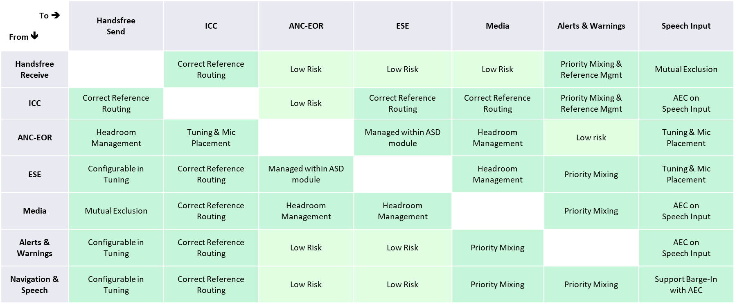
Software systems: QNX interaction risk solution
</>
Source Unit with QNX
Amplifier
Amplifier
14

Slide 15
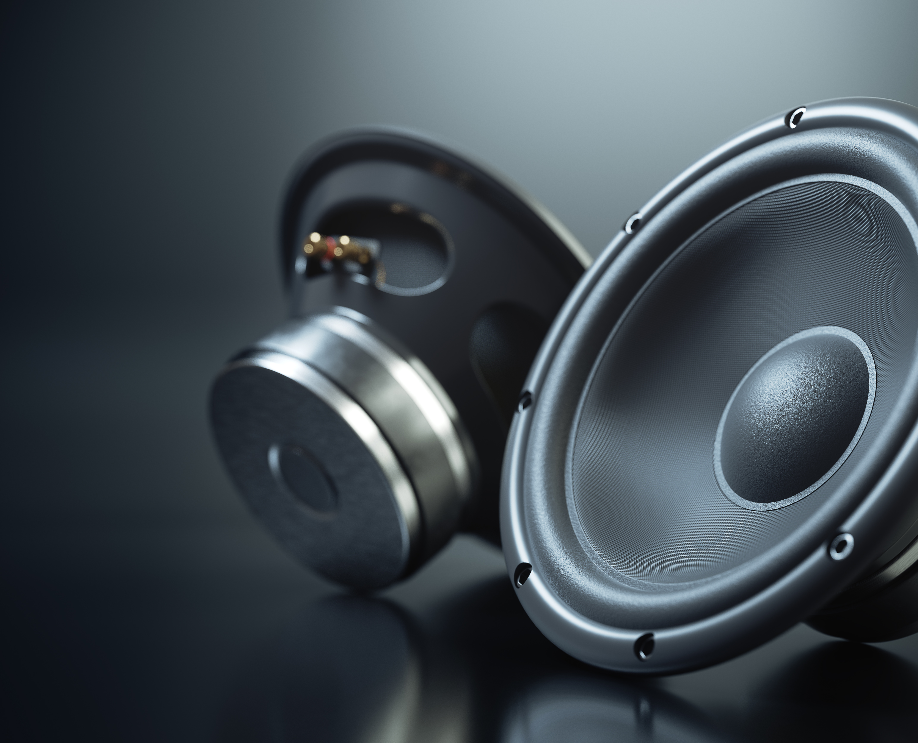
Why QNX acoustics?
100% software-based approach, portable and OS-independent including support for DSPs
Pre-integrated modules
Flexible licensing model i.e., pay as you activate in mass production systems
Scalability across base radio systems to premium sound systems
Collaboration with NVH Simulator partners (VI-grade, HEAD Acoustics)
In fact, the QNX® Acoustics Management Platform can provide an estimated 17.4% cost savings per audio system.* The QNX® Acoustics Management Platform can provide an estimated 6.0% mass savings per audio system.*
Disclaimer: **Comparison based on a single 5-door compact car model with engine sound enhancement and a 10-speaker premium branded audio system. Cost and mass savings may vary
© 2022 BlackBerry Limited. All Rights Reserved.
15
Notes:
100% software-based approach, portable and OS-independent including support for DSP
Pre-integrated modules
Flexible licensing model i.e., pay as you activate in mass production systems
Scalability across base radio systems to premium sound systems
Collaboration with NVH Simulator partners
(VI Grade, Head Acoustics)

Slide 16
Thank you

